Slide 1

PROJECT
HEROPHILUS
An open-source healthcare community focused around making Data an Asset named after a teacher and educator

Slide 2
Agenda
Background
Data as a Platform
Real World Usage
Reference Materials

Slide 3

Background
Setting the stage
EDIT SLIDE SUBTITLE HERE
Some details and core background

Slide 4

Healthcare Industry Perspective
Vendors control access to the data within their platforms, and getting access to the data is costly
Separation of data into silos (clinical, administrative, financial, etc.) and other industry areas has created an unneeded challenge
Industry standards have been in place for almost forty and are not solving problems
Government mandates are used to drive change and force potential innovation

Slide 5

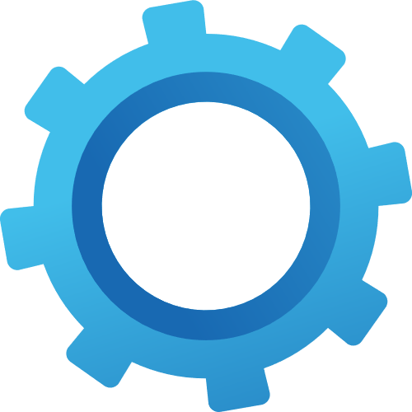


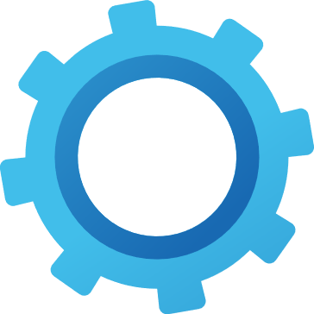


Project Herophilus Perspective
Rethink data: Data is a product
Core mindset: As a Service
Drive Innovation
Enable development and operational efficiency
Support multiple implementation models : on-premise, single public cloud, multi-cloud or all of the above
Support using existing technologies when and where possible

Slide 6

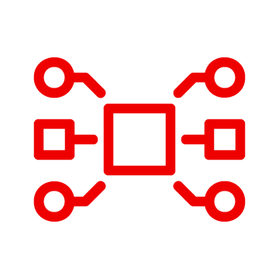
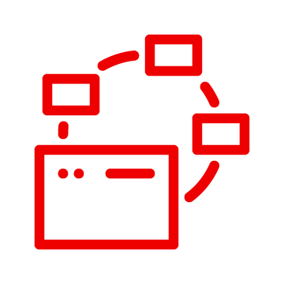
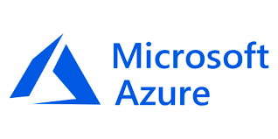
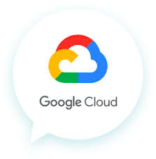

Our Focus: Solve Business Challenges
Business innovation
Technical Enablement and Agility
Operational Simplification
Deliver customer centric value
Show data-driven capabilities
Minimize operational challenges
Enable innovation, increase productivity, and offer better data-driven products and services
Provide data with development, including PaaS and SaaS services
Deliver data seamlessly and consistently with insight

Slide 7
Our Data Approach
Cloud from the Ground Up
Connectivity and Standards
Application, Data & Integration Focused
Reference Architecture Approach
Open Source Focused
As a Service Mindset
Specifically designed and developed for modern implementation needs with support for legacy and current industry needs
Meet Data Where it is
Support for current and legacy connectivity along with industry standards including custom vendor SDKs, APIs, and CLI’s
Team Silos can remain in place
Focused on enabling consistency around access to data. Leverage existing technology where needed
Start with a proven approach
Built to enable scale and extensibility while providing the ability to expand and extend based on implementation needs
Think Globally, act Locally
A community-based mindset enables us to drive changes based on feedback without limiting implementations.

Slide 8
Key Aspects to our Data Approach
Data Connectivity/ Ingestion
Synthetic and/or
De-Identified/Anonymized Data
The ability to connect and process data from legacy and modern systems types. Included with this is the ability to process industry and non-industry standards data.
The ability to have a substantial amount of data that can be used for all aspects of development activities.
A
B
Data Simulation
Application Framework
To enable data simulation for various aspects of testing, demonstrations and implementation quick starts.
The ability to do a variety of custom implementation activities for an enterprises business drivers and needs.
C
D
Auditing / Error Handling and Stats for Everything

Slide 9

Data as a Platform
Drive Solutions and Platforms
What we have enabled and it’s purpose and intent

Slide 10

Secure, Scalable and Extensible
Security
Defined per implementation
HIPAA compliant
All connectivity settings are managed through deployment, sensitive settings are ONLY deployed as secrets within technology and can only be changed via deployment
Scalability
Tunable by component and implementation
Extensibility (As A Service Mindset)
Event driven focus based on implementation and processing needs
Data integration with application development, application integration and data science enablement in one offering
Industry and technology standards focus for consistency and ease of maintenance
Leverage numerous industry adopted tools for improved operational insight

Slide 11
Key Components in Data Approach
Security
Integration Framework for HDF
Application Framework for HDF
Data Connectivity/ Ingestion
Data Simulators
Synthetic and De-Identification/ Anonymization Data
Enterprise Data Enablement/Enrichment
Connect Cloud
Connect CMS Blue Button
Connect CMS Interoperability
Connect EDI
Connect HL7
Connect SAP
Connect Third Party
Simulate HL7
Simulate FHIR
Simulate Third Party
DataSynthesis
Defianz
DataTier
DMN-Routing
IMO-Terms
Public Cloud
CernerAPIs
OMOP Persistence
FHIR Bundle Processor
Intelligent Router
Notifier
Auditing / Error Handling

Slide 12
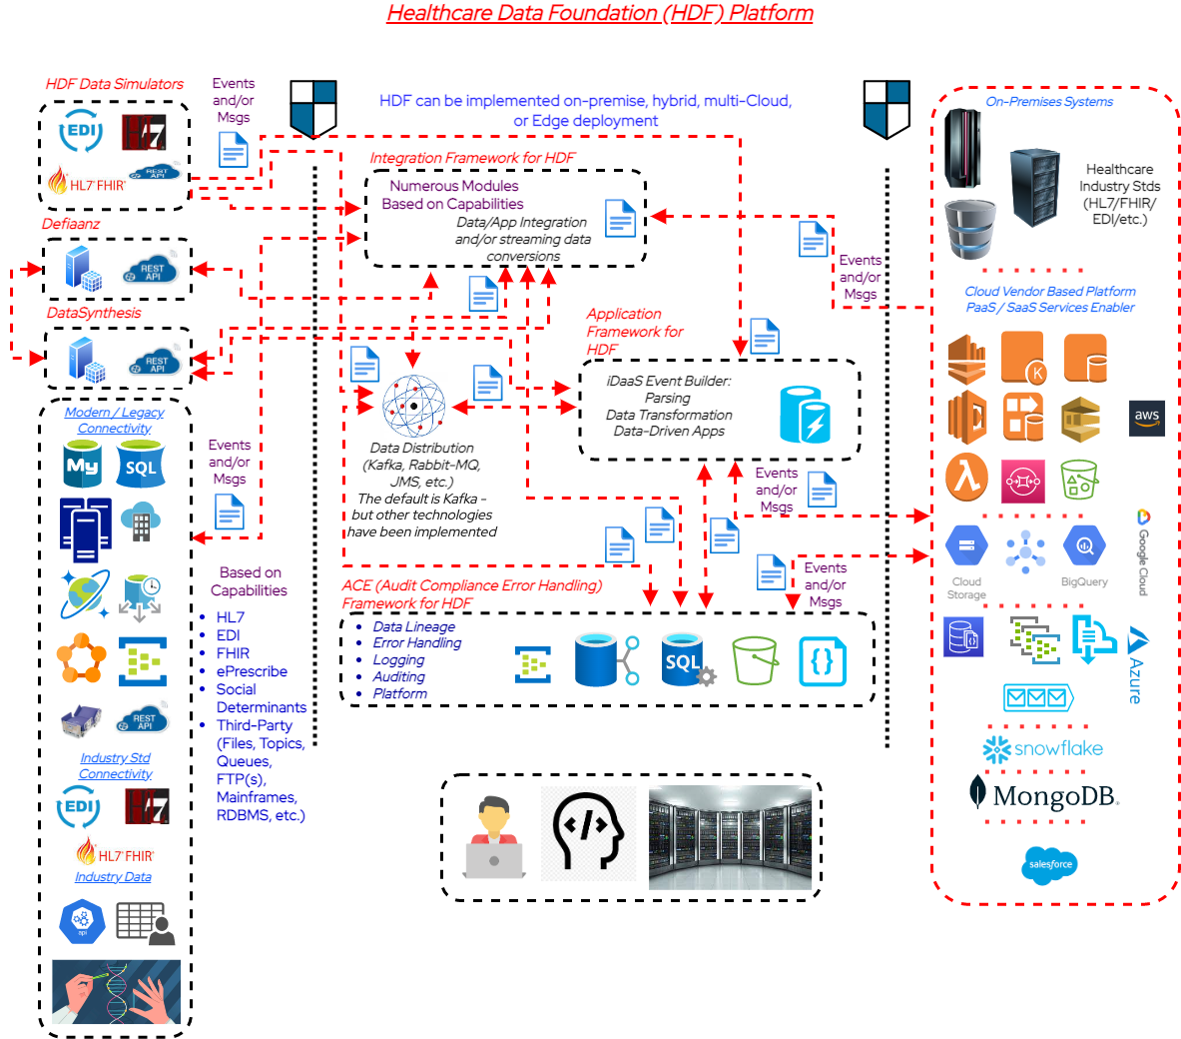
Here is the Platform
Business Drivers
Modernize integration and application development capabilities
Enable innovation while reducing risks to existing technologies
Data enablement / potential commoditization
Operational efficiency
Cloud Innovation enablement
Business Benefits
Improved ROI and time to market – innovate at the speed of business with an as a service mindset
Technology co-existence over replacement
Event-driven healthcare: sensing and responding to real-time data
Secure/Scalable and Extensible
Public Cloud connectivity focused

Slide 13

Real World Usage
How Has it Been Used
EDIT SLIDE SUBTITLE HERE
Implementation focused enabler.

Slide 14

Common Use Cases Supported
General HL7 v2.x and CCDA (with conversions to FHIR)
FHIR Resource processing
EDI HIPAA messages
Medical Device data
sFTP/Files data processing and streaming
RDBMS connectivity to streaming events
Public Cloud PaaS/SaaS services enablement
What we do to help healthcare realize the value of their data and the power of innovation

Slide 15

How Is It Being Used
Application developers to data integration resources have built:
Business-driven focused application(s) from legacy to modern business enablement:
Healthcare Industry Standards-based data integration: HL7, FHIR, etc
Legacy general data processing capabilities: Files, RDBMS, Mainframe, etc.
Chatbots for healthcare with real-time clinical data
Foundational data platforms for payer(s), providers and countries
Cloud providers PaaS and SaaS enablers
Embedded within several partner (6+) data-driven assets
Industry interoperability groups for testing

Slide 16
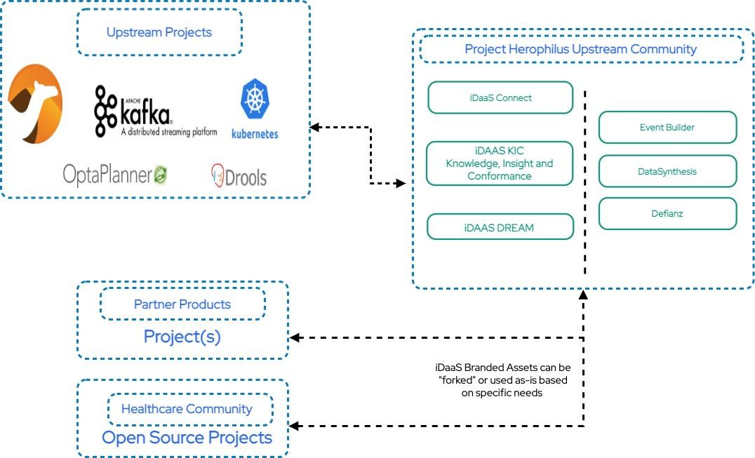
Where Does Open Source Fit In
Project Herophilus is the upstream community. Red Hat is very active with IBM’s contributions growing
There is NO requirement for anyone to have to commit back anything they customize or issues they resolve
All assets are provided “as is” under Apache-2.0 Licensing

Slide 17


Reference Materials
Supporting Content
EDIT SLIDE SUBTITLE HERE
Any related content for this platform can be located here.

Slide 18
Open-Source Links
iDaaS has been rebranded to
Healthcare Data Foundation and each module is also being renamed. The work to change all the assets in underway and projected complete Jan 30
Upstream intelligent DaaS GitHub Site: https://github.com/Project-Herophilus/
iDaaS Connect: is how iDaaS can process data from potentially from hundreds of available systems, industry standards and data formats. The ability to connect to/from systems is iDaaS Connect, within this one repository there are dozens of defined modules for connecting to data such as Blue Button, HL7, FHIR, EDI, APIs, Kafka, JDBC, FTP/FTP(s), File, SAP, Cloud Vendor(s) and many more included. While it is one repository it has all the iDaaS Connect branded modules within it.
https://github.com/Project-Herophilus/iDaaS-Connect
iDaaS KIC: KIC (Knowledge, Insight and Conformance). This is the place where all auditing, error handling and iDaaS insight occurs. This platform includes both an internal (iDaaS) and an external data processing capability with endpoints available for easy system connectivity.
https://github.com/Project-Herophilus/iDaaS-KIC
DataSynthesis: Open-Source platform for building synthetic/fictitious data for business/healthcare needs. Has over 100B data attributes for immediate usage and contains over 20+ data-specific areas
https://github.com/Project-Herophilus/DataSynthesis
Defianz: Open-Source platform for de-identification and/or anonymization.
https://github.com/Project-Herophilus/Defianz
Data Simulators: Designed and being implemented to help healthcare resources test iDaaS and validate implementations. Included within several of the modules are the ability to “blast” systems with transactions to performance test as well.
https://github.com/Project-Herophilus/DataSimulators
iDaaS DREAM: DREAM (Data Real Time Enterprise Automation). Implementable and extensible data applications built to support business needs. This repository contains assets developed in Java, JavaScript, and Quarkus.
https://github.com/Project-Herophilus/iDaaS-DReAM
Docker Hub:
All projects are being re-tooled to land in Docker Hub with automated CI/CD automation.howing
https://hub.docker.com/search?q=rhhcarch&source=community

Slide 19
Common Questions
Question | Notes/Detail
iDaaS is a Product? | No, and it will never be. It was developed to show the power of technologies and what they can do within healthcare. It is key to note that ever capability is native within Red Hat technologies so while iDaaS is not a product and supported everything specific components do like iDaaS Connect is Fuse and moving to Camel-K/Camel-Quarkus based.
Proven Design Pattern Extensible for Consulting and Product Development | We actively have six partners and growing that have implemented solutions that are “white labeled” atop iDaaS capabilities.
Supports Implementation with other technologies | We have seen implementations leverage different technologies for areas like queuing, data persistence, mapping tools and so forth.
Healthcare and Industry Standards support | iDaaS is being used in healthcare for HL7, FHIR, CCDA and various other healthcare specific transactions. We are also actively starting payer initiatives with EDI enablement as well. We also have detailed support for non-industry data types like CSV Files, web services, REST and more…. We also, natively have public cloud SaS and PaaS vendor support fully integrated
Cloud Native or Cloud Enabled | iDaaS was built from the ground up to run within containers and/or on infrastructure. Implementations of both exist.
Data Model Support | iDaaS is built with NO focus on a specific data models we have supported efforts with OMAP and other data formats.
Platform Administration / Monitoring | ALL iDaaS modules have a specific industry standard interface from a leading open source effort (https://hawt.io/). This same technology is widely adopted across companies and the same exact interface style numerous Red Hat products have.

Slide 20
Common Questions (cont.)
Question | Notes/Detail
is iDaaS just code | iDaaS is a design pattern/reference architecture that has a branded set of capabilities built atop upstream technologies. We started with leveraging one key technology that many other companies use: Red Hat, SAP, WS02 and numerous others, Apache Camel (https://camel.apache.org/). It is one of the most popular open-source community for a long time. It also features hundreds of connectors, documentation and a vibrant community sustaining it. Starting in August of 2022 we have expanded our enablement and now also are starting to feature assets developed with vendor CLI’s, API’s and so forth. Within, iDaaS DREAM and other components there are Node and Quarkus based assets. iDaaS does have EVERYTHING we discuss available immediately for usage and implementation from GitHub with our container images running in Docker as well. Check out the community we have grown at https://github.com/project-herophilus. We also have started building implementation guides based on feedback please check the main implementation page out

Slide 21

Rebranding - Asset Renaming Starts 1/23
iDaaS will become Healthcare Data Foundation (HDF)
iDaaS Connect will become Integration Framework for HDF
iDaaS DREaM will become Application Framework for HDF
iDaaS KIC will become ACE (Audit, Compliance and Error Handling) Framework for HDF
Data
Is
The
Asset
Provided By Red Hat Healthcare

Slide 22
THANK YOU
Join our community, and help us make a difference

